Slide 1
AARA:
How Can I Apply?

Slide 2
Eligibility for AARA
HOSES, Diverse | HOD, GO, DP | GO
The SEP Department (HOSES) and Diverse Learning Coordinator ensure that AARA will be applied for on behalf of any student with a verified disability or diverse learner. This will be reviewed and updated annually. | Any student (or their parent/caregiver) with a medical condition, bereavement, misadventure or an event affecting assessment due date/s engages with the Head of Department (faculty or Junior Secondary), Guidance Officer (GO) or Deputy Principal (DP). | Any student (or their parent/caregiver) with a mental health condition engages with the Guidance Officer (GO), ensuring they have medical documentation.

Slide 3
The student access an AARA application form (via school website or HOD / GO / DP) and attains necessary documentation to be considered: Parent/Caregiver note outlining special circumstances i.e. death in family Medical certificate for illness or injuries over a period of time Evidence of a verified disability such as an Education Adjustment Program (EAP).
For an ‘extension’, the student sees the subject teacher and faculty HOD to complete page two of the AARA application form. Once fully complete, the student (or parent/caregiver) returns the required documentation to the HOD Junior Secondary prior to the assessment due date. HOD JS consults required parties and notifies the family, teacher and faculty HOD of the outcome of the AARA application.

Slide 4
AARA Application Form
The AARA Application Form that students and parents/caregivers will need to fill out can be found on our school website https://macgregorshs.eq.edu.au/support-and-resources/forms-and-documents/documents
Alternatively, students can collect a copy of the AARA Application form from the Head of department (faculty or Junior Secondary), Deputy Principal or Guidance Officer.

Slide 5
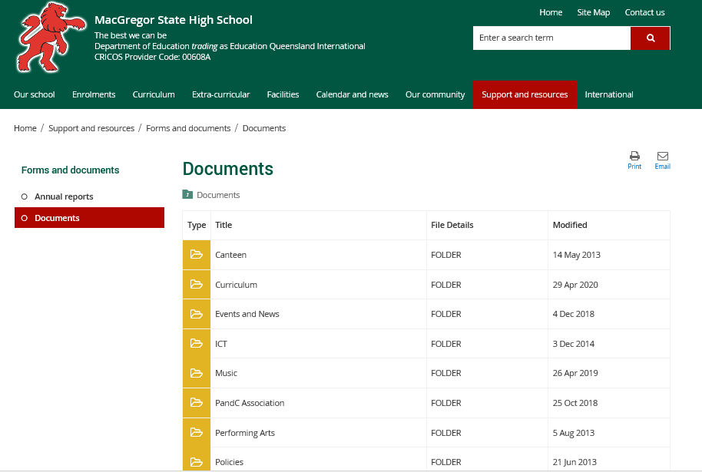

Slide 6
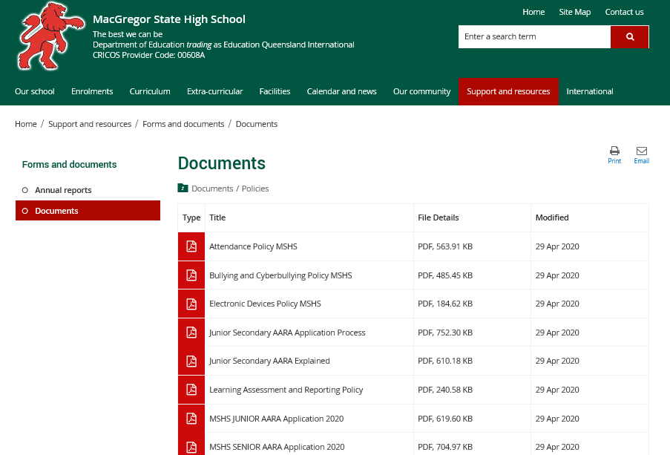

Slide 7
Absence from a Scheduled Exam
A student who is absent on the day of the test/examination is required to complete an AARA application form (with appropriate documentation) no later than seven days from the date that the Parent/Caregiver is notified by the teacher that the student has missed the examination, should they wish to apply for AARA
Once an AARA application form and the necessary supporting documentation has been received from the student, the teacher and curriculum Head of Department will negotiate a date for the student to sit the exam (next available opportunity), confirmed by Junior Secondary Head of Department once AARA is approved
If a student is absent from the examination and does not provide any reasonable documentation then an NR (Not Rated) is given for this assessment item.

Slide 8
Timelines for Applications
It is necessary for an AARA application to be made no later than one week from the original assessment date
Applications submitted close to the due date for assessment should not be for known long-term conditions
Submit documentation and application at Student Services or electronically via email to: aara@macgregorshs.eq.edu.au.

